Slide 1
Software Engineering and Architecture
MiniDraw
A Framework Example
and lots of patterns

Slide 2
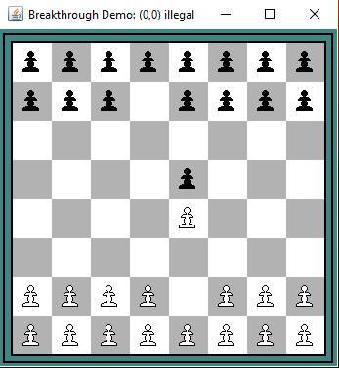
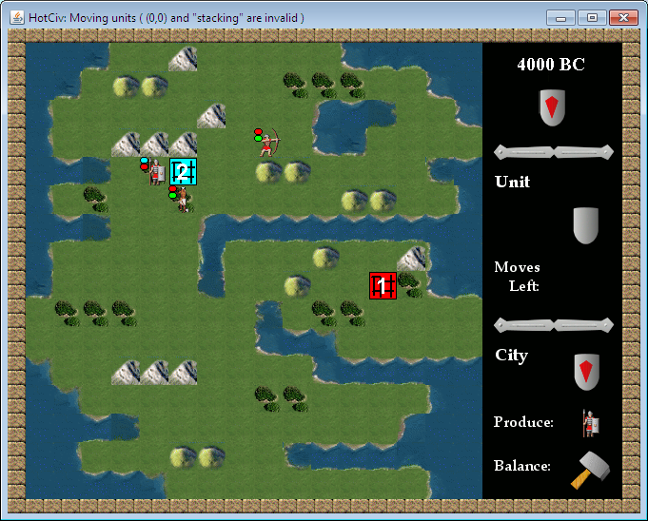
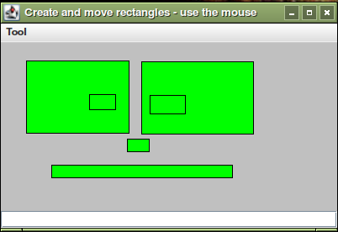
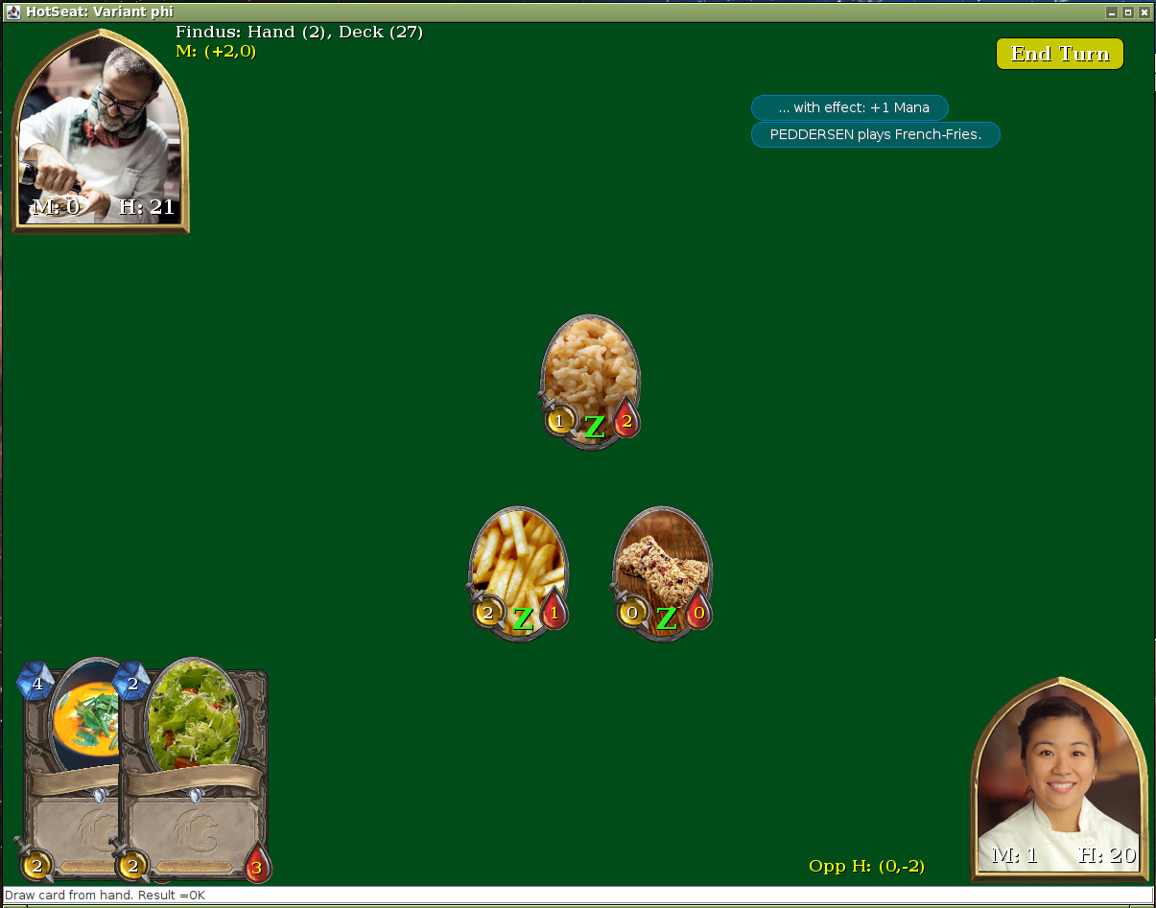
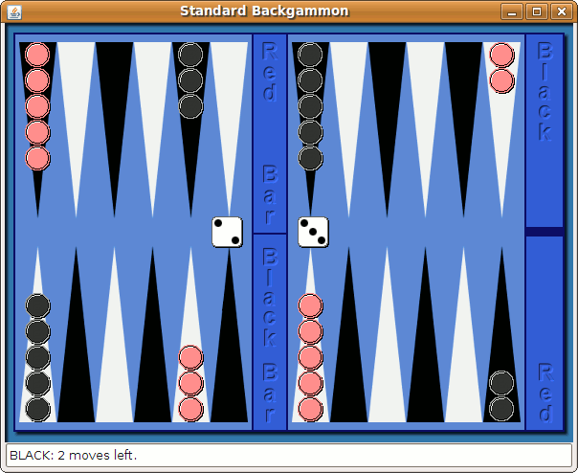
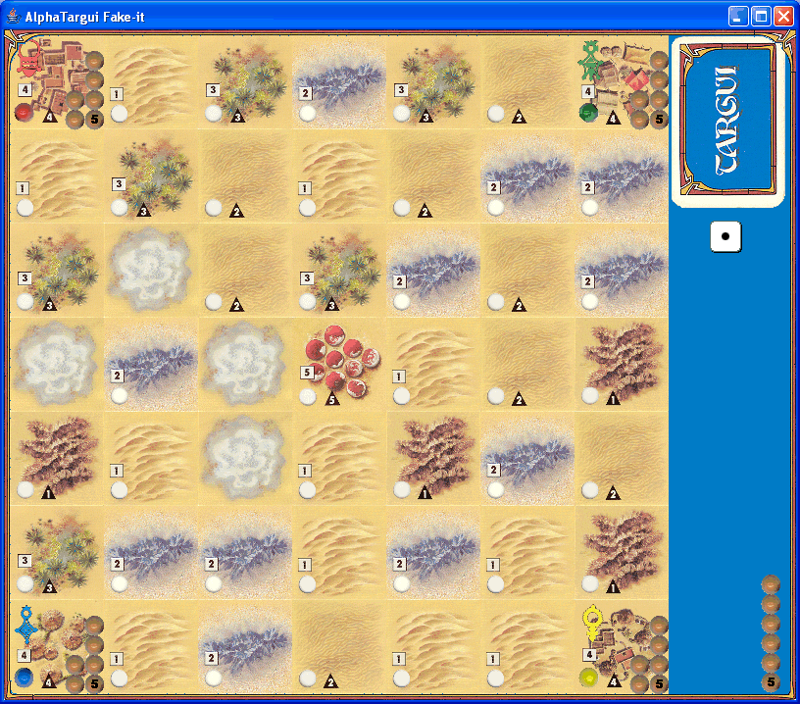
What is it?
[Demo]

Slide 3
What do I get?
MiniDraw is a framework that helps you building apps that have
  2D image based graphics
    GIF/JPG files
    Optimized repainting ☺
  Direct manipulation
    Manipulate objects directly using the mouse
  Semantic constraints
    Keep objects semantically linked
Focus: 2D graphical systems like board game GUI’s.

Slide 4
History
MiniDraw is downsized from JHotDraw
JHotDraw
  Thomas Eggenschwiler and Erich Gamma
  Java version of HotDraw
HotDraw
  Kent Beck and Ward Cunningham.
  Part of a smalltalk research project that lead to the ideas we now call design patterns and frameworks

Slide 5
MiniDraw 3.0
I did extensive rewriting of MiniDraw Spring 2022.
  HotStone required more elaborate control of
    Z-ordering
    Concurrency (supporting ‘poor-man-animation’ using threads)
  And the architecture was rewritten
    Much more compositional approach than in JHotDraw
Interesting observation
  There were numerous tricky bugs that had never been exposed during the last 15 years !
    Anti-Composition Axiom: System testing != Unit testing

Slide 6

Our first MiniDraw application

Slide 7
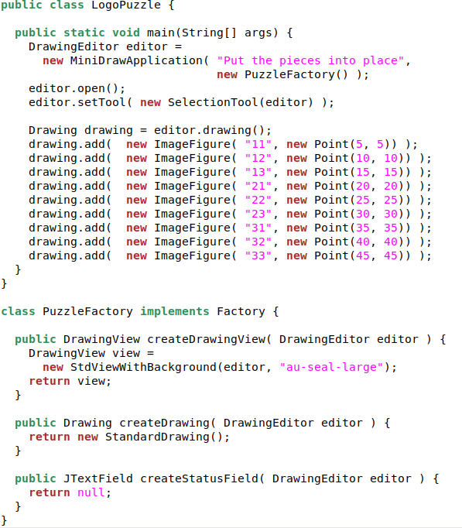



DrawingEditor
  “Project manager”/Redaktør
  Default implementation
Figure
  Visible element
  ImageFigure
Drawing
  container of figures
Tool
  = controller
Factory
  create impl. of MiniDraw roles
DrawingView
  view type to use...

Slide 8
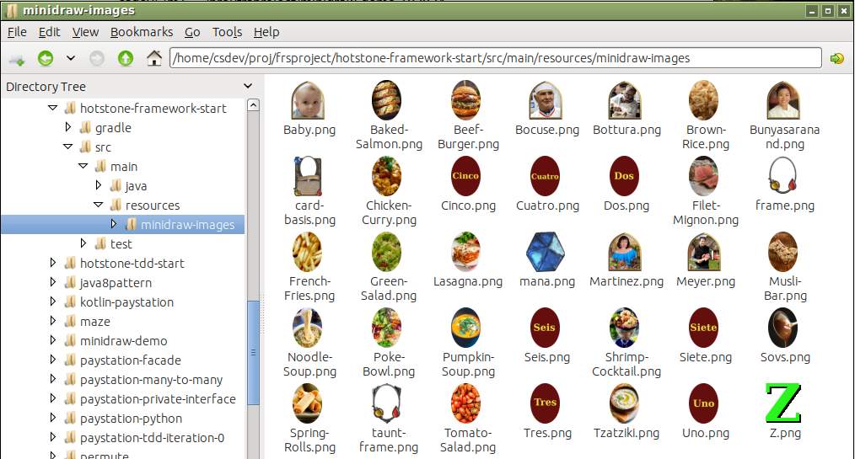
Convention Over Configuration
How does MiniDraw know about images?
  Gradle ‘resources’ folder must have ‘minidraw-images’ folder

Slide 9
The Patterns in MiniDraw
Not what but why?
The 3-1-2 principles in action again...

Slide 10
MiniDraw’s Software Architecture
Main JHotDraw architecture remains
  Model-View-Controller (MVC) architectural pattern
    In Minidraw:
      Model = Drawing
      View = DrawingView
      Controller = Tool
  And a central ‘sub-pattern’ in MVC is
  Observer pattern event mechanism

Slide 11
MiniDraw software architecture
All 2D GUI systems I know of, use these!
  Model-View-Controller architectural pattern
    Java Swing
    Android UI
  Observer pattern event mechanism
    Java Swing
    Android UI (and ‘managers’)
    Every window-based operating system (Windows/Mac/Ubuntu)
      Programs react to mouse events emitted by window manager

Slide 12
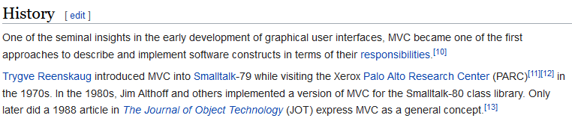
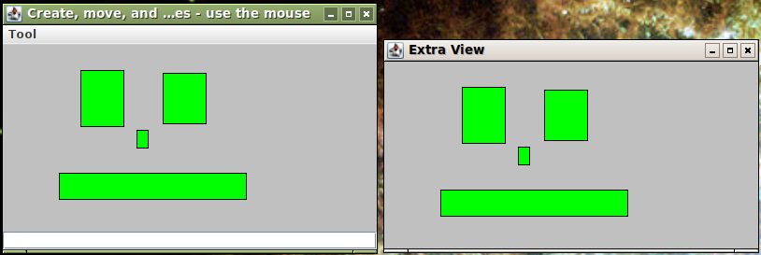
MVC’ problem statement
Challenge:
  writing programs with a graphical user interface

Slide 13
MVC’ problem statement
Challenge:
  writing programs with a graphical user interface
  1) multiple open windows showing the same data – keeping them consistent
  2) manipulating data in many different ways by direct manipulation (eg. move, resize, delete, create, ...)
    i.e. switching tool will switch the object manipulation

Slide 14
Challenge 1
Keeping multiple windows consistent?
Analysis:
  Data is shared but visualization is variable!
  ③ Data visualization is variable behavior
  ① Responsibility to visualize data is expressed in interface: View
  ② Instead of data object (model) itself is responsible for drawing graphics it lets someone else do the job: the views
Model
*
<<interface>>
View
update()
View B
View A

Slide 15
Challenge 2
Few mouse events (down, up, drag) translate to open-ended number of actions (move, resize, create, ?) on data.
  Events are the same but manipulation is variable
  ③ Data manipulation is variable behavior
  ① Responsibility to manipulate data is expressed in interface: Controller
  ② Instead of graphical view itself is responsible for manipulating data it lets someone else do the job: the controller
View
<<interface>>
Controller
mouseDrag()
Move
Select
Model

Slide 16
Observer
Challenge 1:
  Also known as observer pattern
Intent
  Define a one-to-many dependency between objects so that when one object changes state, all its dependents are notified and updated automatically.
We covered Observer in Week 7 ☺

Slide 17
State
Challenge 2:
  Also known as state pattern
Intent
  Allow an object to alter its behavior when its internal state changes. The object will appear to change its class.
  i.e. when the editor is in “draw rectangle” state, the mouse events (click, drag, release) will create a rectangle; when in “select object” state, the same (click, drag, release) will move an object…

Slide 18

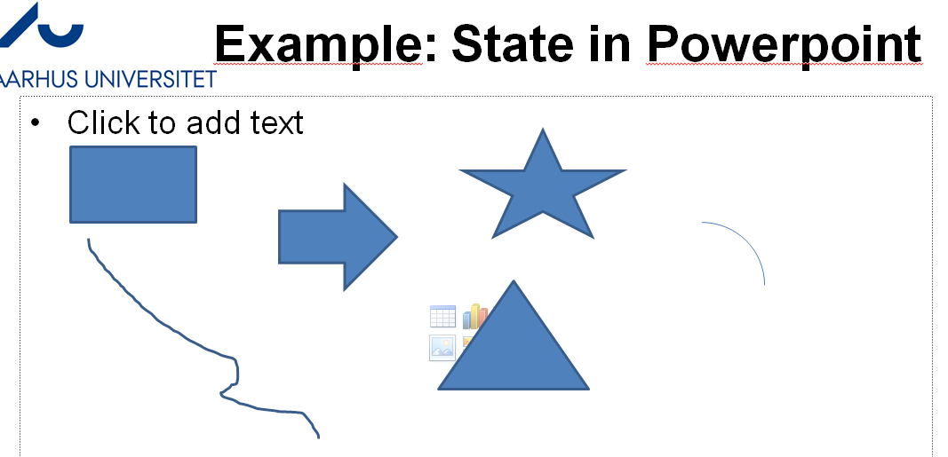
Example: State in Powerpoint
State!

Slide 19
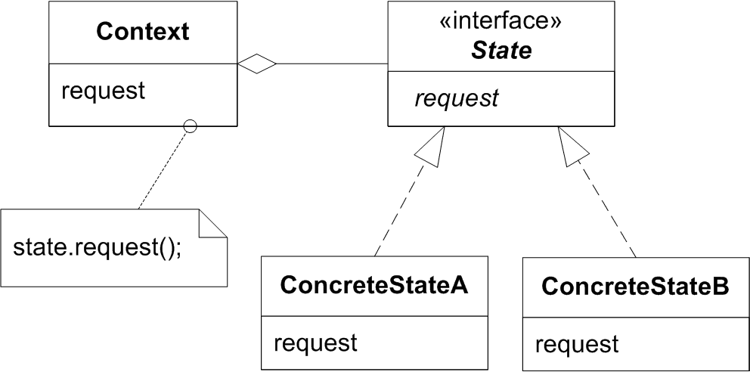
State
Consequences
    the manipulation that is active, determines the application state (“am I moving or resizing figures?”)
    open ended number of manipulations (run-time binding)
    need not know all states at compile time
      change by addition...

Slide 20
Architectural Pattern: MVC
The MVC is an architectural pattern because it defines a solution to the problem of structuring the ’large-scale’ / architectural challenge of building graphical user interface applications.
But the ’engine behind the scene’ is a careful combination of state and observer...
  That again are example of using the 3-1-2 variability handling process.

Slide 21
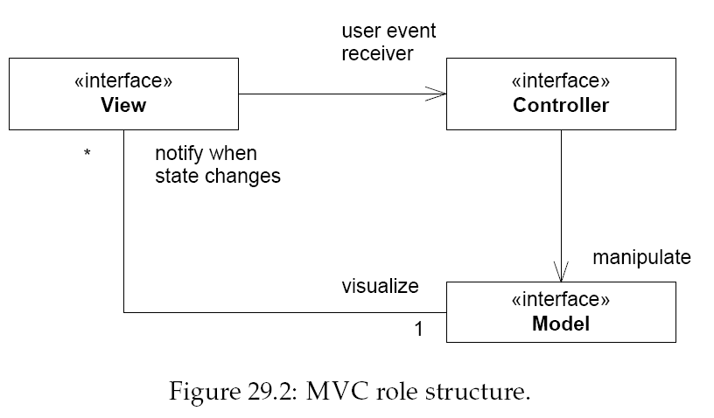
Static view

Slide 22
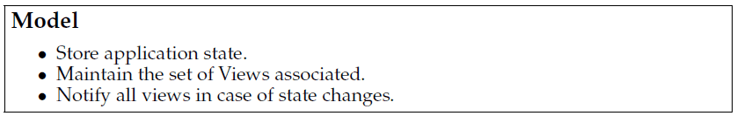
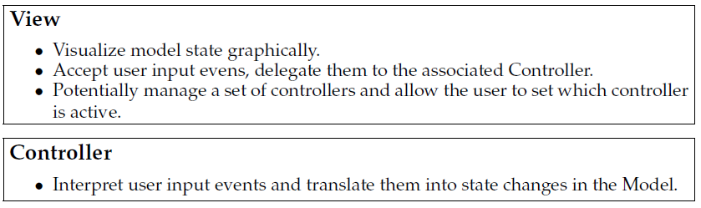
Responsibilities

Slide 23
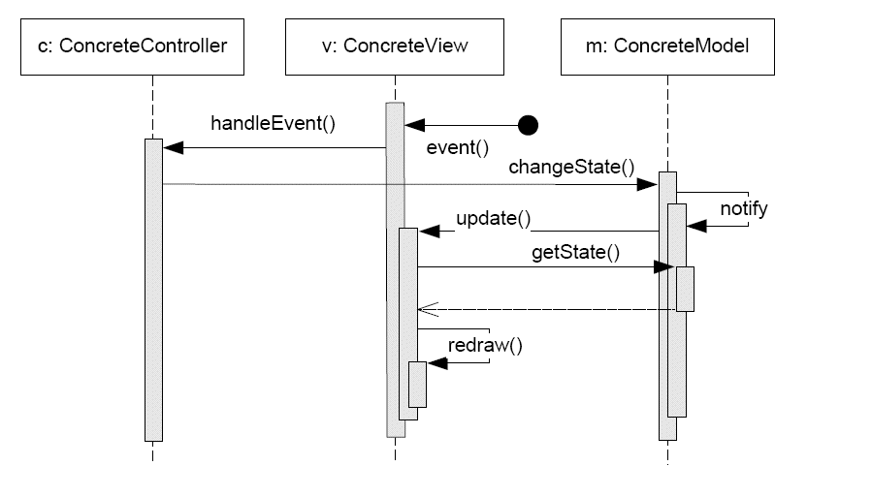
Dynamics

Slide 24
Discussion
So much pain for so little???
  To draw one lousy pixel with the mouse…
  I have to code
    A tool/controller to intercept mouse events
    Send it to the model
      That does state change
      That notifies…
    Some registered observers/view
      That receives the event
      And then finally draw stuff
Exercise:
  Why all this pain???
Notes:
We now have two well defined roles whose behaviour we can change and thus intercept the eventflow to provide behaviour that we best see fit – I can create new tools that manipulate state in certain ways, I can change the storage model for special purposes, I can create observers that renders the state in different ways!

Slide 25
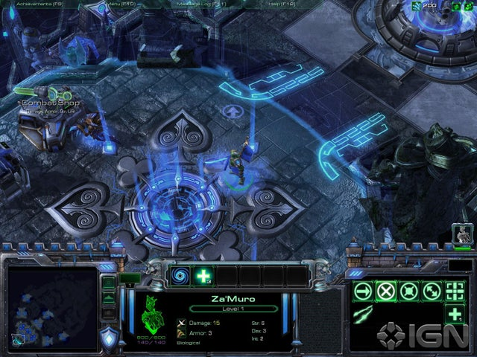
Visualizing MVC
Starcraft II

Slide 26
Visualizing MVC
Three Views

Slide 27
Visualizing MVC
Many Controllers

Slide 28
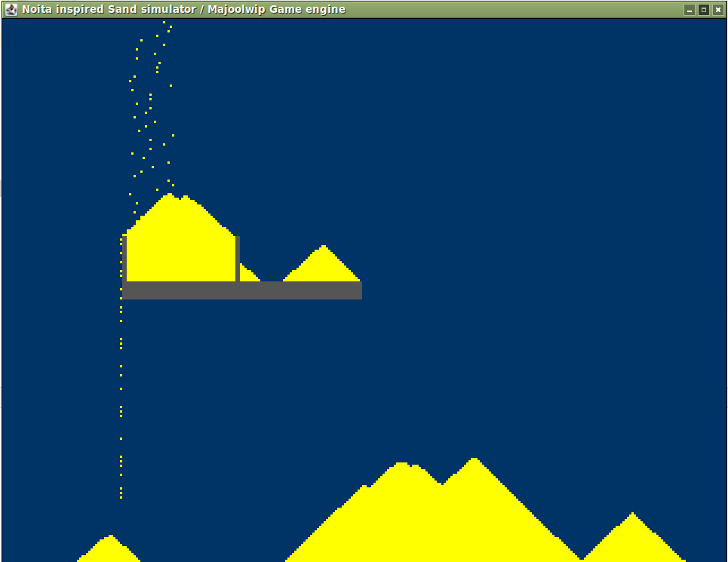
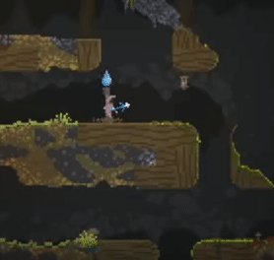
(Side note)
Never too old to play ☺…
In the 80’ies, there was not
enough memory for
  The Model
  The Gfx that rendered the model
So
  The Model was the pixels drawn!
Noita follows this tradition ☺
Notes:
Meta: Project ‘gameengine’ in bitbucket. Task ‘gradle run’.

Slide 29
MiniDraw
Outline of its Architecture

Slide 30
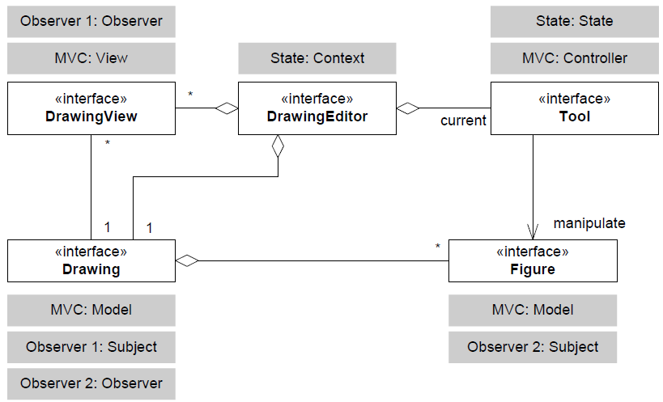
MiniDraw: Role Diagram

Slide 31
Tool: The Controller role

Slide 32
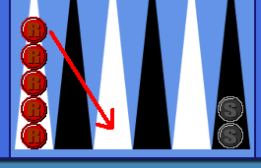
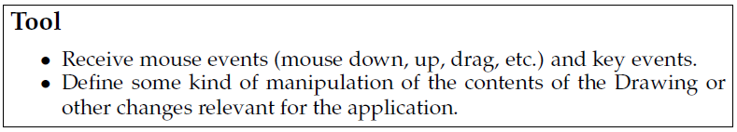
MiniDraw: Tool Interaction
Basic paradigm: Direct Manipulation
[Demo: puzzle]

Slide 33
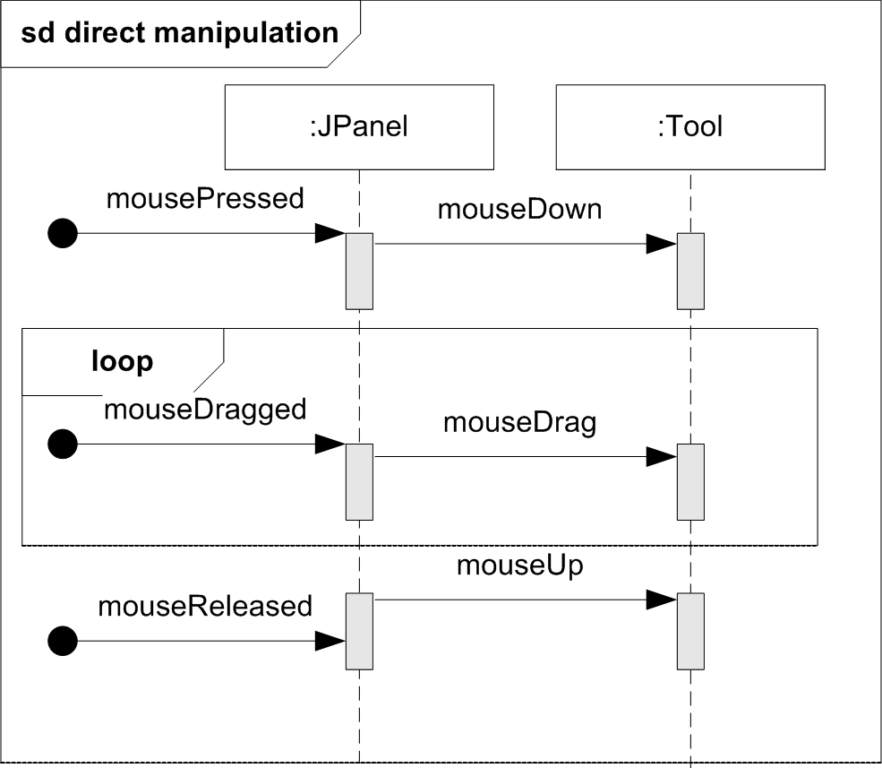
View -> Controller interaction
Mouse events do hit the Swing JPanel, but MiniDraw simply delegates to its active tool...
  The State pattern in
  action
    Let the tool do the job

Slide 34
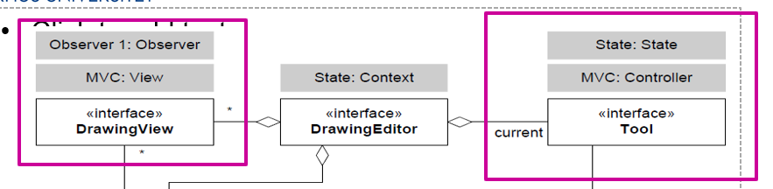
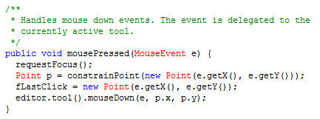
MiniDraw vrs MVC
MiniDraw uses a ‘middle man’: The Editor
  The view requests access to the editor’s current tool
    Aka: delegating the request to state.request()

Slide 35
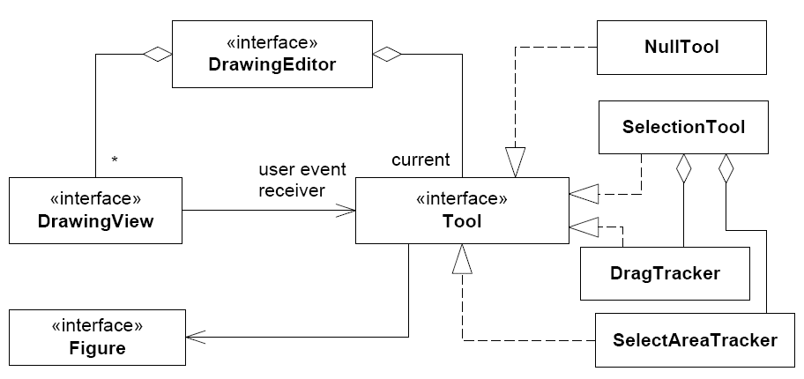
Tools
MiniDraw has some simple tools defined

Slide 36
Code view
It is very simple to set a new tool:
editor.setTool( t );
where t is the tool you want to become active.
Framework: You can define your own tool types!
  A framework hotspot
This is the code equivalent of this UI tool box

Slide 37
Drawing: The Model role
MiniDraw 3.x rewrote the
code base to be purely
compositional.

Slide 38
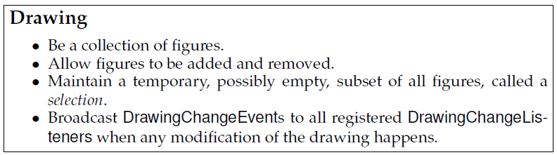
Drawing
Drawing – is responsible for quite a lot…
How to model that in the compositional paradigm?
  By composition, of course!
… and we partially covered that in Week 6: Compositional Design

Slide 39
The Interface in MiniDraw
So – it is defined in terms of fine-grained roles
  Role interfaces

Slide 40
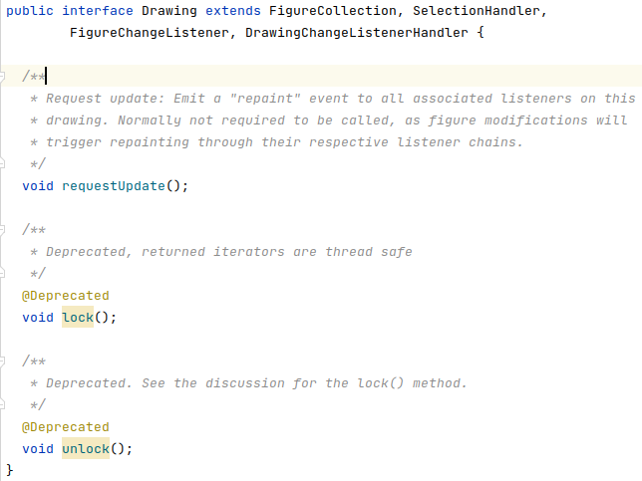
And the Interface is nearly Empty
One little extra responsibility is all there is…

Slide 41
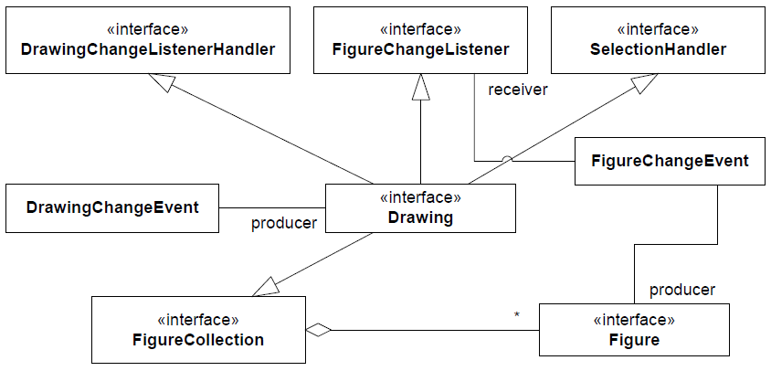
MiniDraw: Drawing
Static view

Slide 42
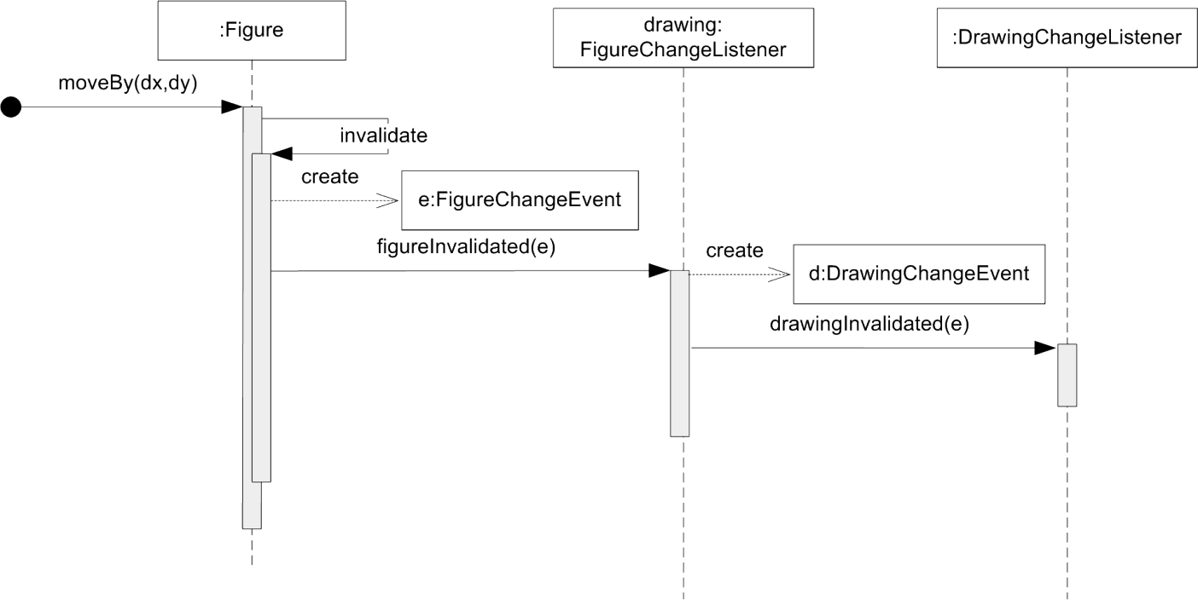
MiniDraw: Drawing
But how does the view get repainted?
  Double observer chain
    Figure notifies drawing, which again notifies drawing view.

Slide 43
Exercise:
Observer pattern has two roles
  Subject: Container of data
  Observer: Object to notify upon data changes
Who are who here???
DrawingView
Drawing
Figure

Slide 44
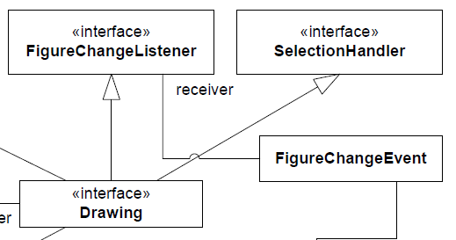
So the last role
The last role that the Drawing serves…
… is to listen to any change
events from the figures it
contains in order to be able
to fire the drawing event…

Slide 45
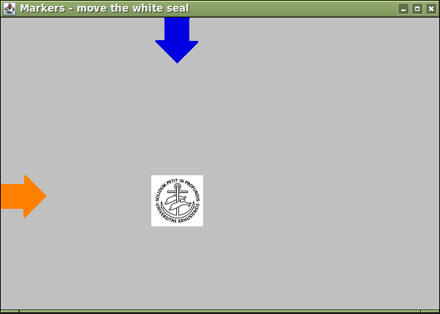
Flexibility
As any object, including a Figure itself, can listen to FigureChangs…
  We can create semantic bindings
MiniDraw can be used for to
create a UML diagram editor…

Slide 46
DrawingView: The View role

Slide 47
View
The View is rather simple
  JPanel to couple MiniDraw to concrete Swing GUI implementation
  Listen to mouse events to forward them to tool/controller.

Slide 48
The Compositional Advantage
Note that this design combines two frameworks
  MiniDraw and Swing
  If DrawingView was not an interface then 
Porting to JavaFX is on the ToDo list!

Slide 49
DrawingEditor: The Coordinator

Slide 50
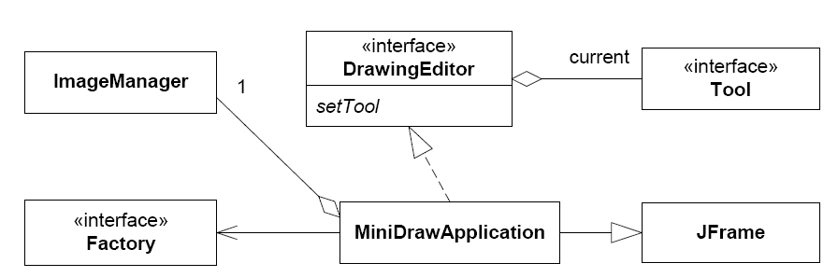
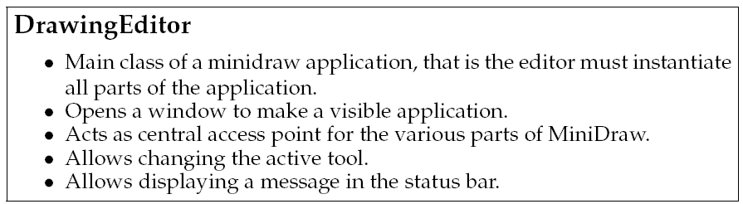
Static View

Slide 51
Implementation

Slide 52
Default Implementations
Most MiniDraw roles have default implementations:
  Interface X has default implementation StandardX
  DrawingView -> StandardDrawingView
There are also some partial implementations:
  Interface X has partial implementation AbstractX
  Tool -> AbstractTool
  Figure -> AbstractFigure

Slide 53
Compositional Design
Complex behaviour as a result of combining simple behaviour...
Example:
  CompositionalDrawing implements Drawing

Slide 54
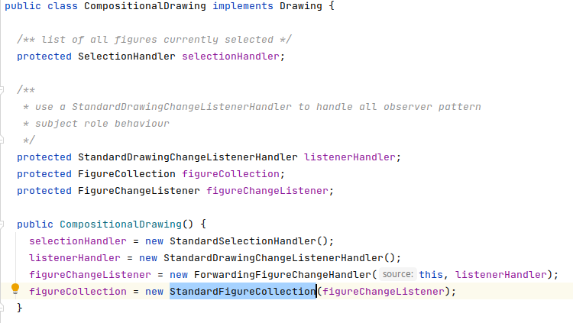
How do we do that?
Proposal 1:
  implement ahead...
Proposal 2:
  encapsulate major responsibilities in separate objects and compose behavior
… and we partially covered that in Week 6: Compositional Design

Slide 55
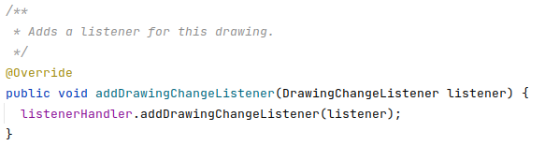

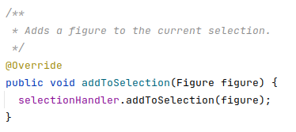
Code view: delegations!
Examples:

Slide 56
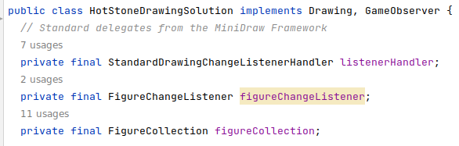
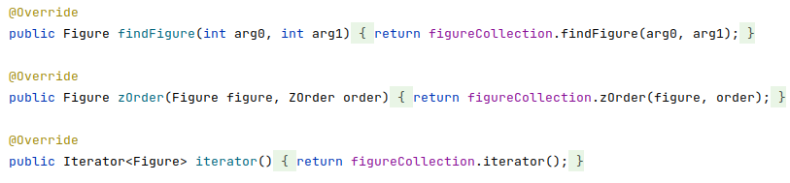
What do I achieve?
Implementing a custom Drawing
  In which the figure collection works differently…
    As in our HotStoneDrawing
  but I can reuse the collection, the selection and drawing-change handler behavior directly!

Slide 57
MiniDraw Variability Points

Slide 58
Variability Points
Images
  By putting GIF images in the right folder and use them through ImageFigures
Tools
  Implement Tool and invoke editor.setTool(t)
Figures
  You may make any new type you wish
Drawing
  Own collection of figures (e.g. observe a game instance)
Observer Figure changes
  Make semantic constraints
Views
  Special purpose rendering

Slide 59
Summary
MiniDraw is
  A framework: A skeleton application that can be tailored for a specific purpose
  A demonstration:
    of MVC, Observer, State, Abstract Factory, Null Object, Strategy, ...
    of compositional design: Make complex behaviour by combining simpler behaviours
  A basis: for the mandatory project GUI.

